Slide 1
Figures from Pure and Mixed Spectra
June 11, 2019
David Gray

Slide 2
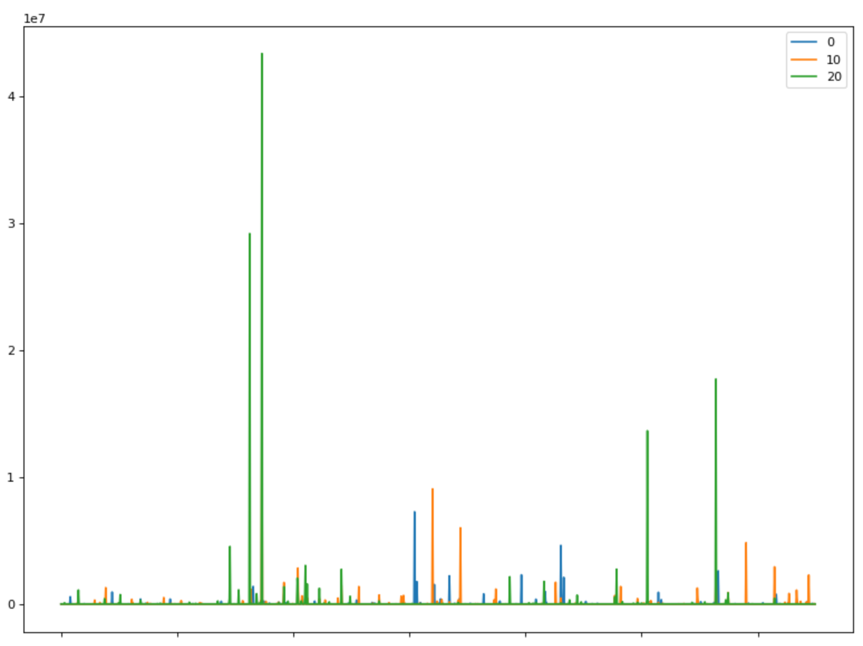
Pure Sample Spectra

Slide 3
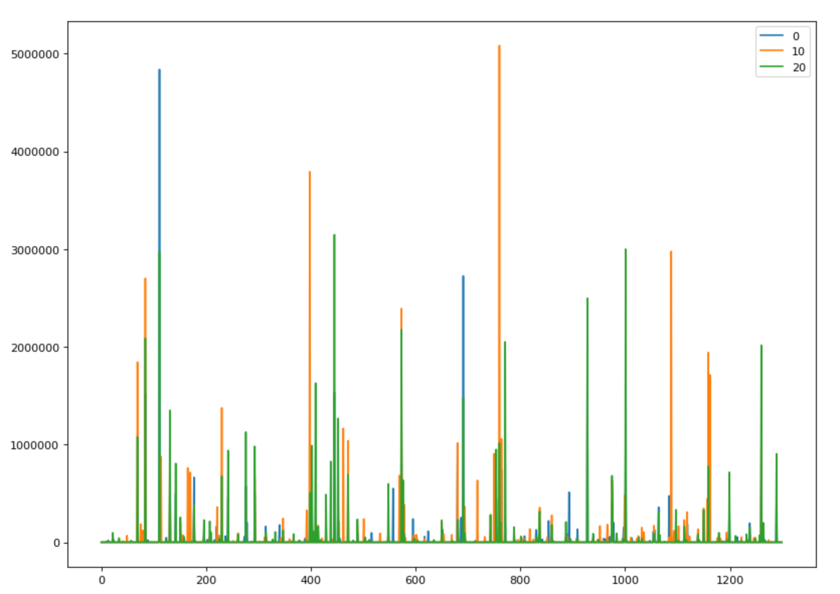
Mixed Spectra

Slide 4
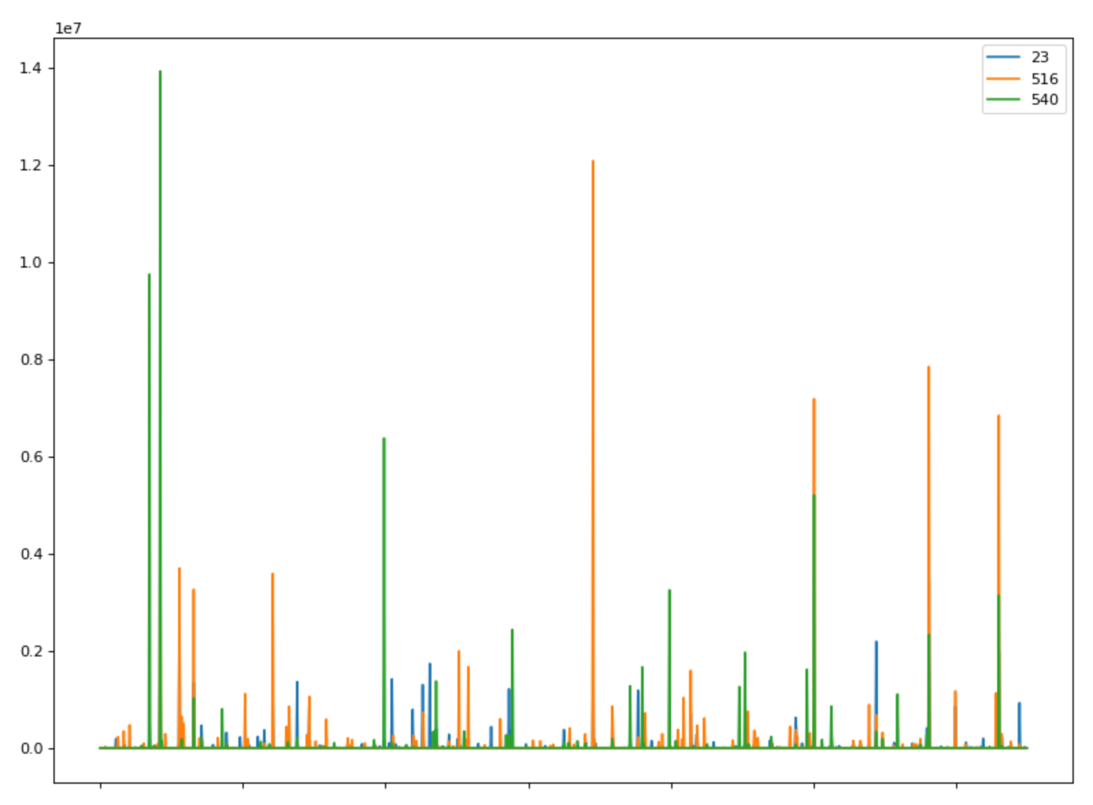
Mixed Spectrum (23) and Pure Spectra

Slide 5
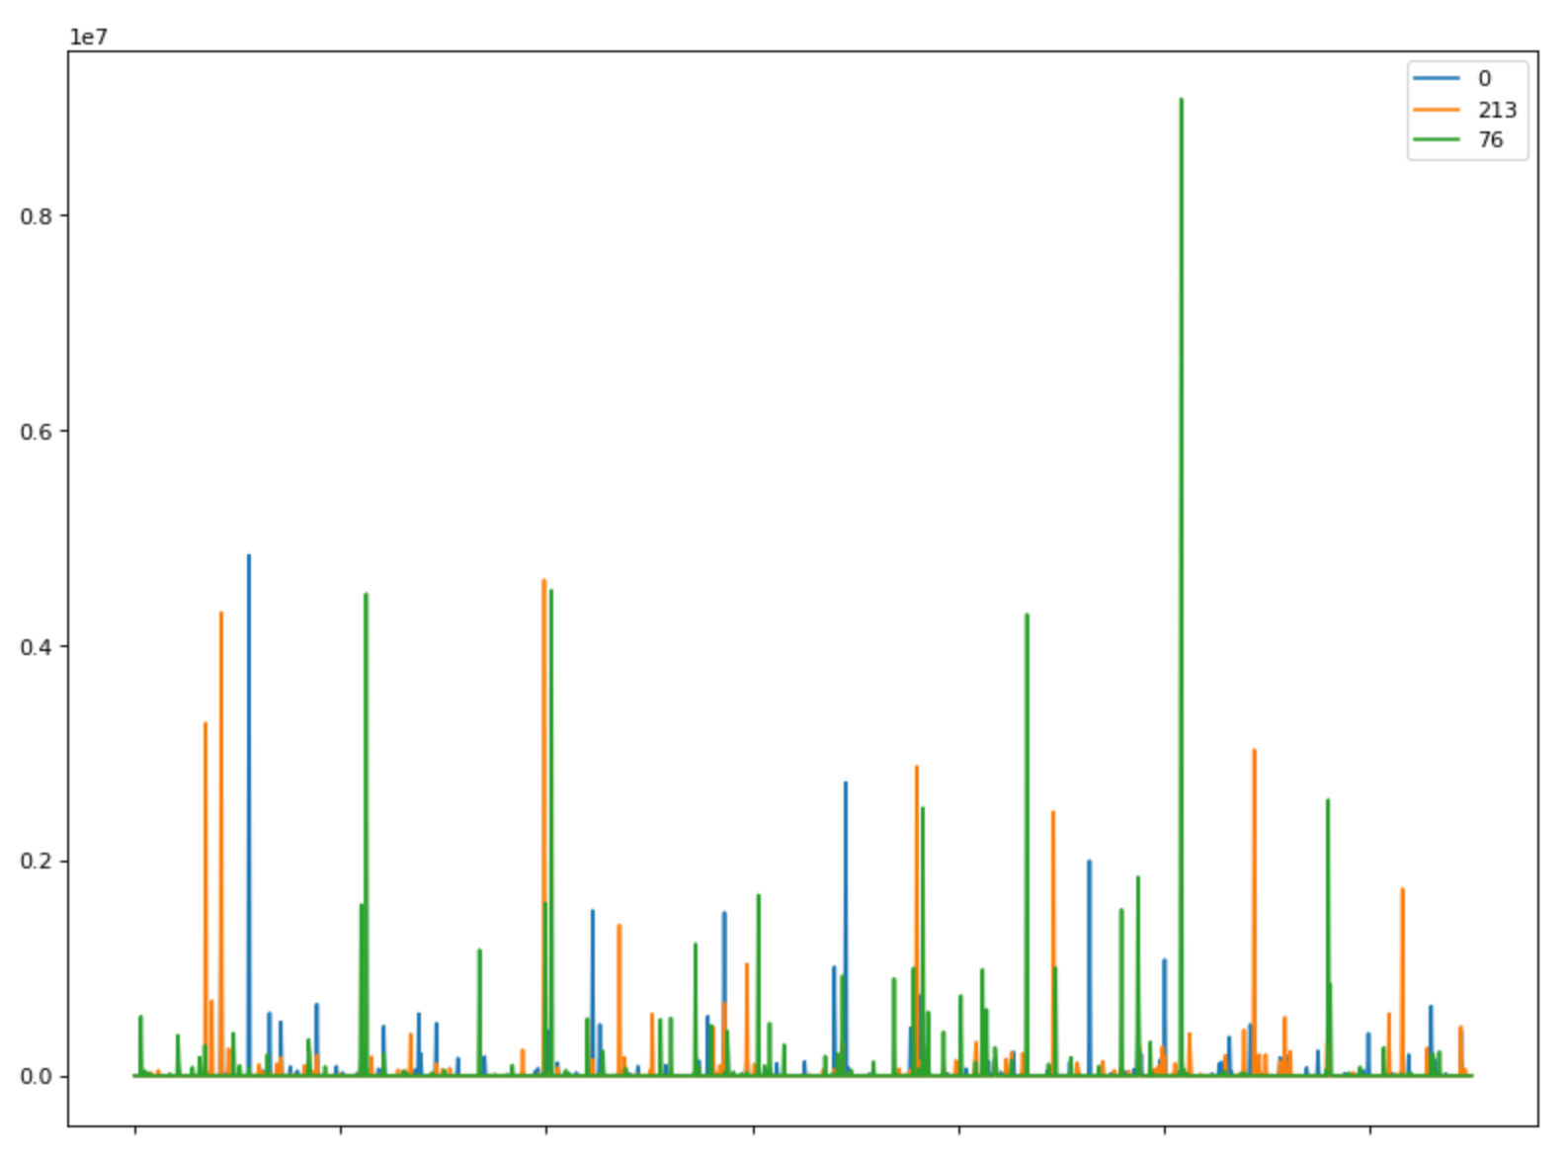
Mixed Spectrum (0) and Pure Spectra (213 not in mixed; 76)

